Slide 1

Apache Kafka Basics
Mateusz Dymiński

Slide 2
Kafka Basics Agenda
What’s Apache Kafka
Basic concepts
Features of Kafka

Slide 3
What is Kafka?
Kafka is a messaging system that is designed to be fast, scalable, and durable.
It is an open-source stream processing platform.
Originated at LinkedIn and later became an open-source Apache project in 2011
Kafka is written in Scala and Java.
It aims at providing a high-throughput, low-latency platform for handling real-time data feeds.

Slide 4
What is Kafka?
Apache describes Kafka as a distributed streaming platform that lets us:
Publish and subscribe to streams of records.
Store streams of records in a fault-tolerant way.
Process streams of records as they occur.

Slide 5

Kafka concepts

Slide 6
Records
Records = message = event
Each record consists of a key, a value, and a timestamp.
Categorized into Topics
Message = byte array
Serializer is not necessary

Slide 7
Topics
A topic is a category to which records are published.
Producers write data to topics and consumers read from them
Topics in Kafka are always multi-subscriber
Topics are partitioned
Topics are persistent – records are stored on the disk

Slide 8
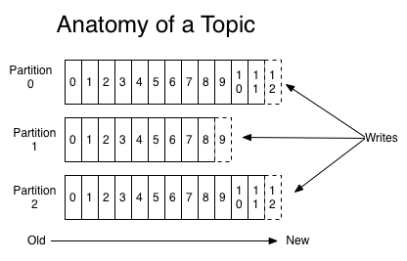
Source: https://kafka.apache.org/intro

Slide 9
Partitions
Each topic has one or more partitions
Order is preserved within single partition
Partitions are replicated across cluster
Records are added to the very end of each partitions

Slide 10
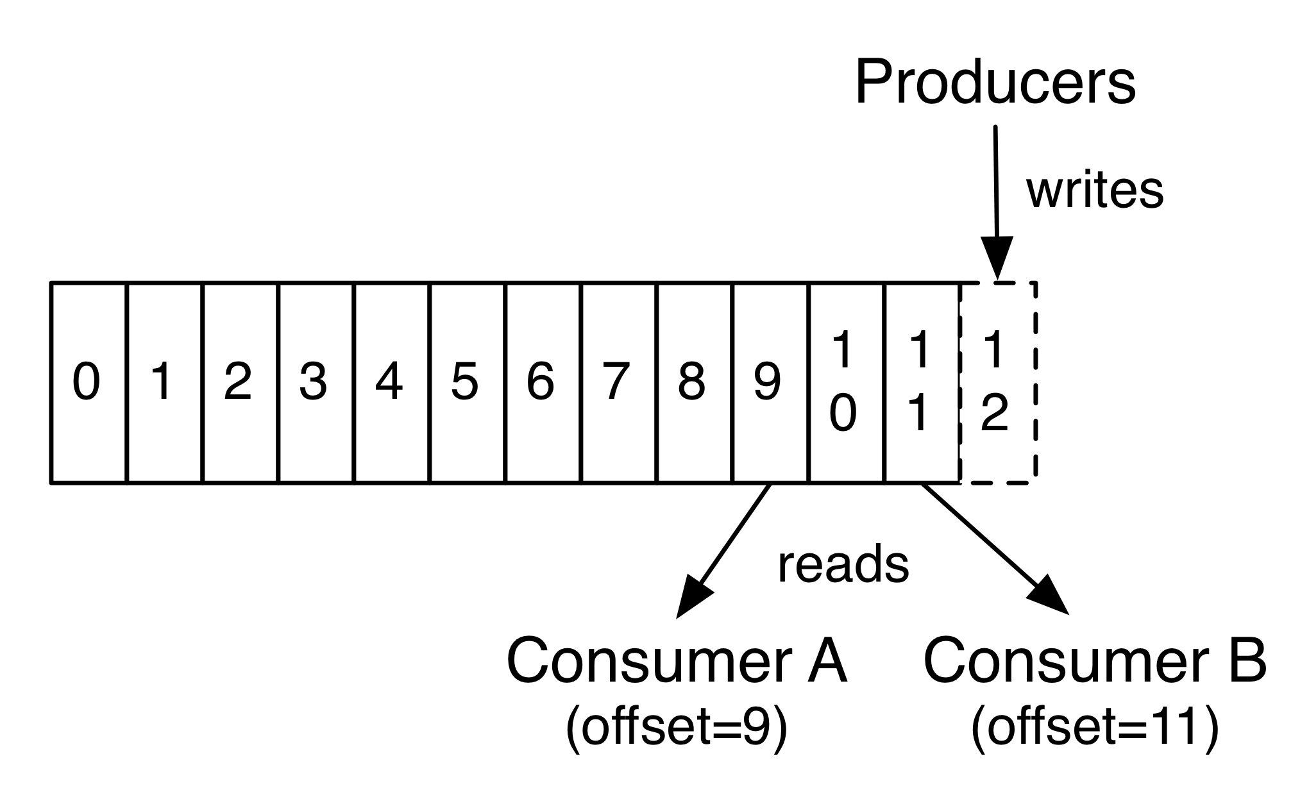
Partition Offset
Each partitioned message has a unique sequence ID called an offset.
Offset is unique per partition only
Source: https://kafka.apache.org/intro

Slide 11
Replicas
Replica is a backup of a partition
Replication factor tells the cluster how many of identical replicas should be created on the cluster
Replicas are never used to read or write data.
They are used to prevent data loss.
There can be one or many replicas of a partition
One leader and many followers
In-Sync Replica is a replica that has enough records to be considered in partition leader election

Slide 12
Brokers
Kafka Broker is a Kafka server that manages records
Receives messages
Assigns offsets
Commits messages to storage on disk
Each broker may have zero or more partitions per topic.

Slide 13
Cluster
When Kafka has more than one broker, it is called a Kafka cluster.
A Kafka cluster can be expanded without downtime.

Slide 14
Zookeeper
It backups the date critical metadata of Kafka Cluster
Responsible for ellection
Stores ACLs
Stores list of available Kafka brokers

Slide 15

Kafka Features

Slide 16
Multi Tenancy
You can deploy Kafka as a multi-tenant solution.
Multi-tenancy is enabled by configuring which topics can produce or consume data
Support for quotas - administrators can define quotas to control the broker resources that are used by clients.

Slide 17
Geo Replication
Kafka MirrorMaker provides geo-replication support.
messages are replicated across multiple datacenters or cloud regions
active/passive scenarios for backup and recovery;
active/active scenarios to place data closer to your users

Slide 18
Guarantees
At a high-level Kafka gives the following guarantees:
Messages sent by a producer to a particular topic partition will be appended in the order they are sent
Consumer sees records in the order they are stored in the log.
Topic with replication factor N, we will tolerate up to N-1 server failures.

Slide 19
Retention
The message remains in the topic for:
Configurable period of time or
Configurable size is reached
Retention is set per Topic

Slide 20
Log Compaction
Retains at least the last known value for each record key for a single topic partition
Compacted logs are useful for restoring state after a crash or system failure.
Used also for deletion of single message

Slide 21
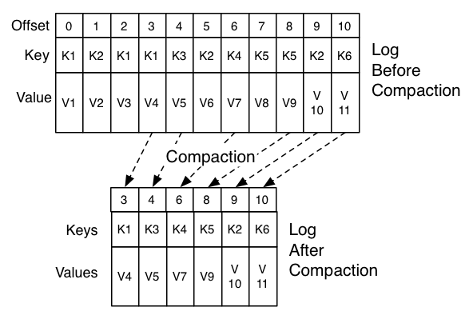
Log Compaction
Source: https://kafka.apache.org/intro

Slide 22
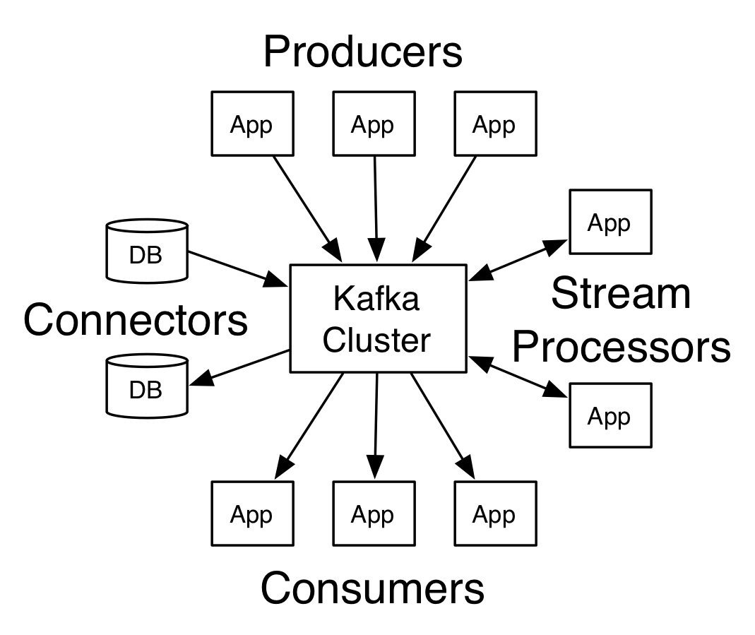
Kafka API
Source: https://kafka.apache.org/intro

Slide 23
Producer API
The Producer API allows an application to publish a stream of records to one or more Kafka topics.

Slide 24
Consumer API
The Consumer API allows an application to subscribe to one or more topics and process the stream of records produced to them.

Slide 25
Streams API
The Streams API allows an application to act as a stream processor, consuming an input stream from one or more topics and producing an output stream to one or more output topics, effectively transforming the input streams to output streams.

Slide 26
Connector API
The Connector API allows building and running reusable producers or consumers that connect Kafka topics to existing applications or data systems. For example, a connector to a relational database might capture every change to a table.

Slide 27

Thanks!

